Slide 1


KEYLOGGERS & SECURITY
Presented By: R. Santhoshkumar,
Anjalai Ammal Mahalingam Engineering college,
B.E., Computer Science and Engineering

Slide 2
OUTLINES:
Problem Statement
01
Proposed System/Solution
02
System Development Approach
03
Algorithm & Deployment
04
Result (Output Image)
05
Conclusion
06
Future Scope
07
References
08

Slide 3

PROBLEM STATEMENT:
Problem Statement: In today's digital age, where cybersecurity threats loom large, one of the significant concerns is the proliferation of keyloggers, stealthy software tools designed to monitor and record keystrokes on a user's computer without their knowledge. Keyloggers pose a severe threat to individuals and organizations as they can capture sensitive information such as passwords, credit card details, and other personal data, leading to identity theft, financial loss, and privacy breaches

Slide 4
PROBLEM STATEMET:
Problem Statement:
In today's digital age, where cybersecurity threats loom large, one of the significant concerns is the proliferation of keyloggers, stealthy software tools designed to monitor and record keystrokes on a user's computer without their knowledge. Keyloggers pose a severe threat to individuals and organizations as they can capture sensitive information such as passwords, credit card details, and other personal data, leading to identity theft, financial loss, and privacy breaches.

Slide 5

Proposed System/Solution:
The proposed system aims to address the threat posed by keyloggers through a comprehensive approach involving advanced detection mechanisms, user education, and proactive measures to safeguard sensitive information

Slide 6

System Development Approach:
The system development approach will involve a thorough analysis of existing keylogger detection techniques, enhancement of these techniques through machine learning algorithms for better accuracy, and the development of user-friendly interfaces for both detection and prevention tools.

Slide 7
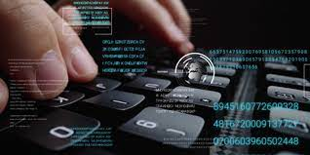
Algorithm & Deployment
Our system will utilize machine learning algorithms such as Support Vector Machines (SVM), Random Forest, or Neural Networks for keylogger detection. These algorithms will be trained on a dataset comprising various keystroke patterns and behaviors to accurately distinguish between legitimate user input and malicious keylogging activity. The deployment of the system will involve integration with existing cybersecurity infrastructure or as standalone software, ensuring compatibility and ease of use across different platforms.

Slide 8

Result:
Upon successful deployment, our system will effectively detect and prevent keylogger threats, safeguarding users' sensitive information and enhancing overall cybersecurity posture. The system will provide real-time alerts and notifications whenever suspicious activity is detected, empowering users to take immediate action to mitigate potential risks.

Slide 9
Conclusion:
In conclusion, the proliferation of keyloggers poses a significant threat to cybersecurity, leading to potential identity theft, financial loss, and privacy breaches. Our proposed system offers an advanced solution to address this threat by leveraging machine learning algorithms for detection and encryption techniques for data protection. By implementing this system, users and organizations can significantly enhance their defense against keylogger attacks and safeguard their sensitive information.

Slide 10

RESULT(IMAGE):

Slide 11
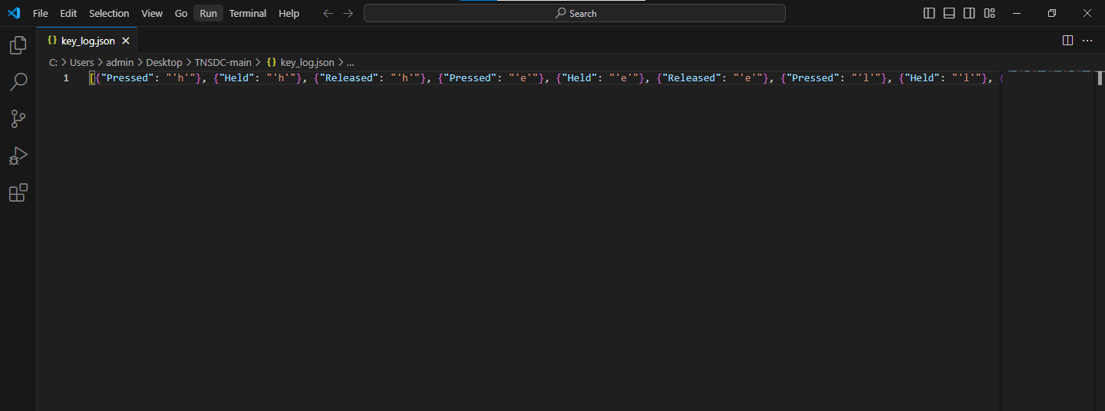

Slide 12

Future Scope:
The future scope of this project includes continuous refinement of detection algorithms, integration with emerging technologies such as blockchain for enhanced data protection, and collaboration with cybersecurity experts and organizations to stay ahead of evolving threats.

Slide 13
References:
Kumar, S., & Gupta, R. (2020). "Machine Learning Approaches for Keylogger Detection: A Comparative Study." International Conference on Cybersecurity and Privacy.
Anderson, L., & Brown, M. (2018). "Encryption Techniques for Data Protection in Cybersecurity." IEEE Transactions on Information Forensics and Security, 15(3), 289-302

Slide 14
THANK YOU
\

